Slide 1
MACHINE LEARNING BASED AUTISM PREDICTION
GUIDE DETAILS NAME:S.KISHORE
DR.P.GEETHA ROLLNO:2019202027
degree:MCA-FINAL YEAR

Slide 2
INTRODUCTION
Autism is a neuro development disorder that affects a person’s communication
Machine learning algorithms are applied to diagnose Autism problem
KNN and SVM – Machine learning algorithm

Slide 3
MOTIVATION AND OBJECTIVE
MOTIVATION:
AIM – To find the child is autistic or non-autistic child using children images
OBJECTIVE:
To make the image clear using preprocessing method
To calculate threshold value, using FCM algorithm.
To extract featurization using DWT and GLCM algorithm.
Finally we are predicting whether the child is autistic or non-autistic by using KNN and SVM algorithm.

Slide 4
LITERATURE REVIEW
S.NO | AUTHOR NAME AND PAPER | CONCEPT IN THE PAPER | DETAILS
1. | Title:Pliable algorithm rgb image convert in gray image using transformation equation. Author name:Moneeb Ahmed | ALGORITHM USED:RGB TO GREY SCALE IMAGE FORMULA IS USED. | ISSUE: 12 December 2019 PUBLISH:IJCSSE
2. | Title:MR Brain Image Segmentation Based on Unsupervised and Semi-Supervised Fuzzy Clustering Methods Author name:Hayat Al-Dmour , Ahmed Al-Ani | ALGORITHM USED:FCM, Semi supervised fuzzy clustering. | ISSUE:17 JUNE 2017 PUBLISH:IEEE
3. | Title:Dwt feature extraction based face recognition using intensity mapped unsharp masking and laplacian of gaussian filtering with scalar multiplier Author name:Gautham Sitaram Yajia, Sankhadeep Sarkara | ALGORITHM USED:DWT LIMITATION: | ISSUE:2nd International Conference on Communication, Computing Security [ICCCS], 2012

Slide 5
SNO | AUTHOR NAME AND PAPER | CONCEPT IN THE PAPER | DETAILS
4 | Extraction of Texture Features using GLCM and Shape Features using Connected Regions Author name:Shijin Kumar P.S and Dharun V.S | ALGORITHM USED:GLCM | ISSUE:12 January 2017 International Journal of Engineering and Technology (IJET) PUBLISH:IJET
5 | Prediction of the Autism Spectrum Disorder Diagnosis with Linear Discriminant Analysis Classifier and K-Nearest Neighbor in Children Author name:Osman alay and Mustafa ulas | ALGORITHM USED:KNN | ISSUE:IEEE 2018
6 | Evaluation of Autism Classification Using Machine Learning Techniques Author name:F. Catherine Tamilarasi and Dr.J.Shanmugam | ALGORITHM USED:SVM | ISSUE:IEEE 2021

Slide 6
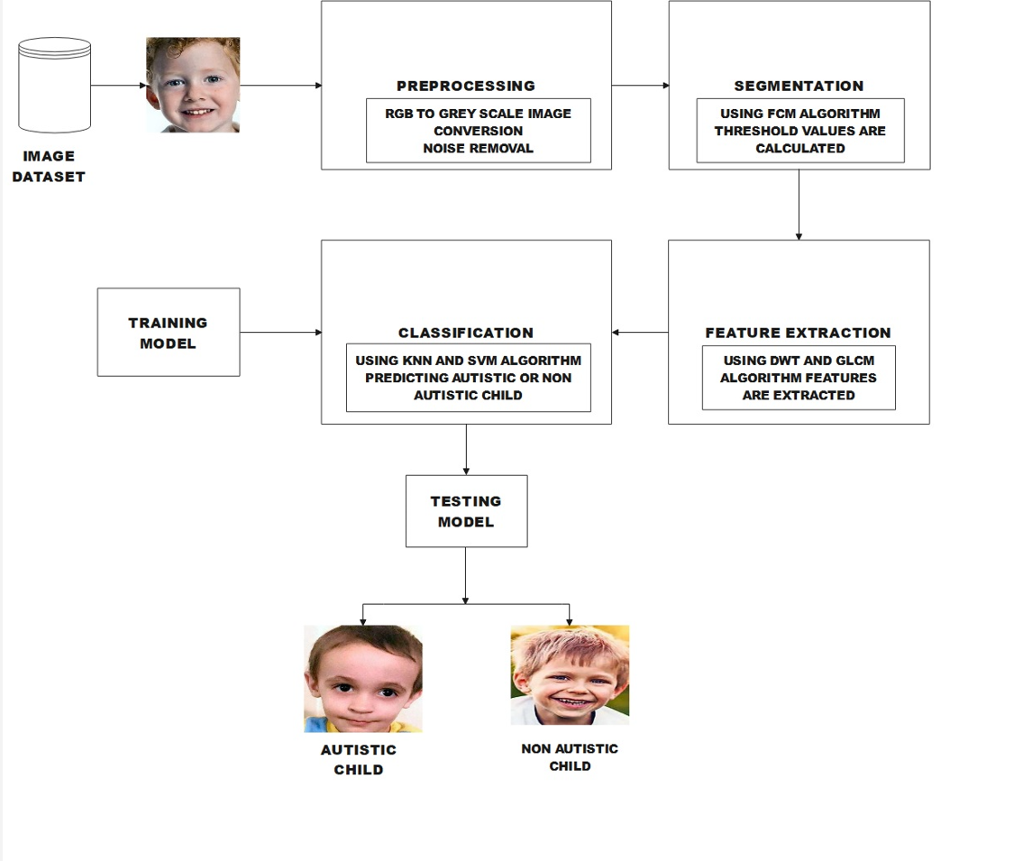
ARCHITECTURE DIAGRAM

Slide 7
LIST OF MODULES
PREPROCESSING
SEGMENTATION
FEATURE EXTRACTION
CLASSIFICATION
PREPROCESSING:
Image is converted from rgb to grey scale format.
Check any external noise is present.
Remove the noise using filter.
The Image is enhanced and sent for segmentation.

Slide 8
SEGMENTATION:
Using FCM algorithm threshold values are calculated.
FUZZY C MEANS ALGORITHM:
Fuzzy c-means (FCM) is a clustering method
Each data point to belong to multiple clusters
With varying degrees of membership.
FEATURE EXTRACTION:
The features such as standard deviation, contract, brightness calculated using GLCM algorithm.
The entropy mean, median,dissimilarity,energy ,homogeneity calculated using GLCM algorithm
The cA,cV, cD, calculated using DWT algorithm.

Slide 9
DISCRETE WAVELET TRANSFORM(DWT):
DWT is a wavelet transform for which the wavelets are sampled at discrete intervals.
DWT provides a simultaneous spatial and frequency domain information of the image.
GRAY LEVEL COOCCURENCE MATRIX(GLCM):
The GLCM functions characterize the texture of an image
By calculating how often pairs of pixel with specific values
In a specified spatial relationship occur in an image.
Creating a GLCM, and then extracting statistical measures from this matrix.
CLASSIFICATION:
Using K-nearest neighbour (KNN) and Support vector machine algorithm(SVM)
The aim is to find child is autistic child or non-autistic
Comparison is also done in this classification.

Slide 10
TRAINING MODEL USING KNN:
The knn model can be trained and fitted using the following steps
Train the model using knn classifier
The trained model is fitted using fitcknn
Save the trained model
TRAINING MODEL USING SVM:
Train the model using SVM classifier
The trained model is fitted using fitceoc .
Save the trained model.

Slide 11
DATASET
The dataset is taken from Kaggle website
70% for training and 30% for testing
URL:
Kaggle.com/code/rafashrafjoy/autism-image-data-vgg19/data
The dataset consist of 3000 images.

Slide 12
ALGORITHM
PREPROCESSING:
INPUT:Image is given as input
OUTPUT:The images are displayed in a grey scale format.
Step1:Start
Step2:Read the images from the dataset
Step3: Plot the images using histogram
Step4:Convert the images from rgb to grey scale image using the formula
C=rgb2gray(B)
Step5:plot the image as grey scale format
SEGMENTATION:
INPUT:Image is given as input
OUTPUT:The values will be displayed as 0’s and 1’s
Step1: Start Step 2: Read the images from the dataset Step 3:Using fcm algorithm Threshold values are calculated Step 4: Using below formula the images are converted from matrix to gray scale image. fim = mat2gray
Step 5: Using the formula image levels are calculated level = graythresh( fim) bw fim = im2bw( fim, level)
Step 6: The Threshold values are given as output.

Slide 13
FEATURE EXTRACTION:
INPUT: Image is given as input
OUTPUT: The values will be displayed
Step 1: Start
Step 2: Read the images from the dataset
Step 3: Using dwt and glcm algorithm,calculating the values as cA, cH,cV,cD.
Step 4: Using the above algorithm Contrast,Correlation,Energy,Homogeneity, Mean, Standard Deviation, Entropy.
Step 5: The Variance,Smoothness,kurtosis,skewness,IDM Values were also calculated.
Step 6: Using the below formula the values are calculated.
Contrast = ∑i,j ∣i−j∣ 2p(i)
Correlation = ∑i,j(i−μi)(j−μj)p(i,j)/σi σj
Energy =∑i,j p(i,j)/2
Homogeneity = ∑i,jp(i,j)/1+∣i−j|
mean = ∑i 1/m*P(i,j)
variance = ∑i∑j(i−μ)2p(i,j)
Entropy = ∑i∑j p(i,j)log(p(i,j))
IDM = ∑i∑j 1/1+(i−j)2*p(i,j)
Skewness =σ4 ∑ ((i - μ)4 .p(i))
Kurtosis = ∑((i - μ)P4 .p(i))P- 3
Standard deviation = ∑√(i - μ)2 .p(i)
Dissimilarity = ∑Pij|i - j|
Smoothness = 1−(1/(1+a))

Slide 14
CLASSIFICATION:
INPUT: Image is given as input
OUTPUT: The values will be displayed
Step 1: Start
Step 2: using K-nearest neighbour algorithm accuracy value is predicted
Step 3: using Support vector machine algorithm,accuracy value is predicted
Step 4:In KNN the model is trained and fitted using
KNNMOdel = fitcknn(Trainfeattraining,label)
Step 5: In SVM the model is trained and fitted using
SVMModel = fitcecoc(Trainfeattraining,label)
Step 6: if l = 1
print(”autism child”)
Step 7: else l = 2
print(”non-autism child”)
Step 8:By comparing both the algorithm KNN and SVM. KNN has the highest accuracy

Slide 15
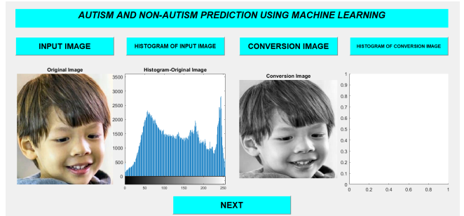
OUTPUT SCREENSHOT
PREPROCESSING:

Slide 16
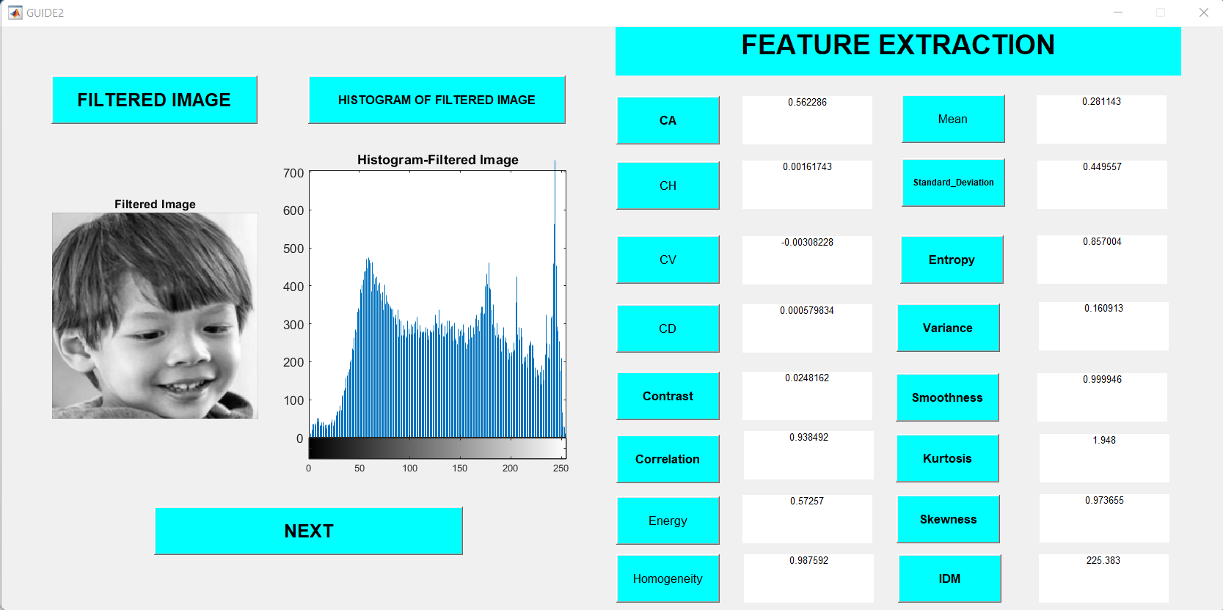
SEGMENTATION AND FEATURE EXTRACTION

Slide 17
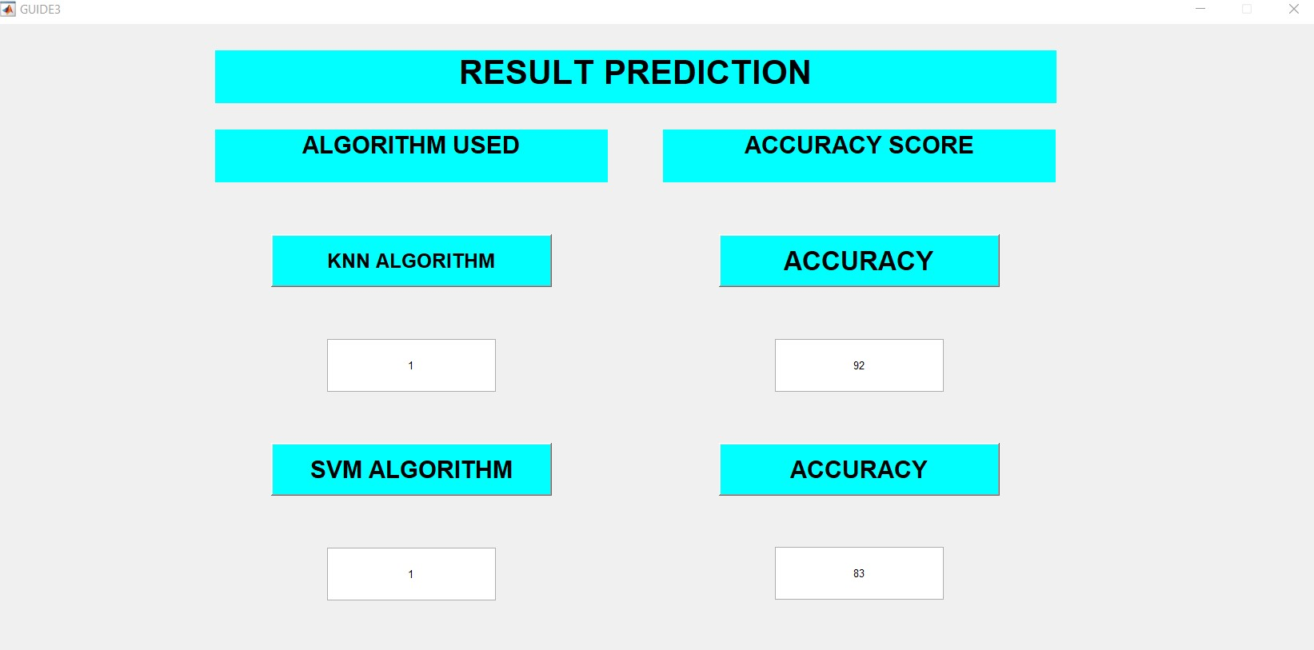
OUTPUT SCREENSHOT

Slide 18
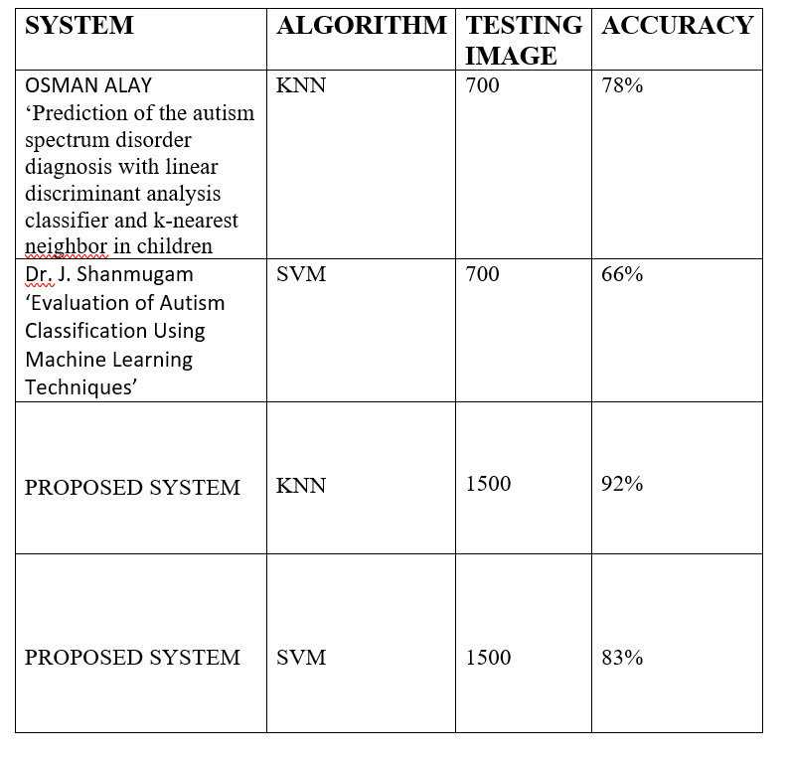
PERFORMANCE ANALYSIS

Slide 19
CONCLUSION:
KNN and SVM is compared
KNN has the highest accuracy rate
In future the children videos are used to determine the child is autistic or non autistic child.

Slide 20
REFERENCES
[1] Moneeb Ahmed. Pliable algorithm rgb image convert in gray image using transformation equation. International journal of computer science and software.
[2] Hayat-Al-Dmour and Ahmed-Al-Ani . Mr brain image segmentation based on unsupervised and semi-supervised fuzzy clustering methods. Elsevier, 2017.
[3] Shijin Kumar P.S and Dharun V.S. Extraction of texture features using glcm and shape features using connected regions, International journal engineering and technology, 2018.
[4] Gautham Sitaram Yajia, Sankhadeep Sarkara, and and S Ramachandran K Manikantana,dwt feature extraction based face recognition using intensity mapped unsharp masking and laplacian of gaussian filtering with scalar multiplier. 2nd International Conference on Communication, Computing Security [ICCCS], 2012.
[5] Osman alay and Mustafa ulas. prediction of the autism spectrum disorder diagnosis with linear discriminant analysis classifier and k-nearest neighbor in children. IEEE EXPLORE.
[6] F. Catherine Tamilarasi and Dr.J.Shanmugam. Evaluation of Autism Classification Using Machine Learning Techniques . IEEE EXPLORE, 2021.

